Slide 1
Hotel Management System
Using Core Java and Swing...

Slide 2

ABOUT US
Anil Yadav
Nidhi
Jaya Kumar S

Slide 3
Contents
20XX
Abstract
Project Objective
System Requirements
Project Scope
Functional Requirements
Application Flow Diagram
Future Scope
Benefits of our project
20XX
20XX
What We Learnt ?
Conclusion

Slide 4

Abstract
This project aims at creating on Hotel Management System which can be used by Admin. The admin to advise the availability of rooms in hotels . They should be able to reserve the available rooms according to their need in advance to make their stay comfortable. The Admin hands the booking information of customers
The administrator will know the details of reservation The hotel department maintain the seat availability and booking details in certain database

Slide 5
Project Objective
To develop a interactive Hotel management System using Java and Swing which :-
Operate a record management system for admin to view available rooms.
Maintain a record of guest who are logging in .
The admin has the power to add, delete, Search and clear the status of the rooms in the hotel.
The records of the added rooms with their availability are stored in the records of the admin.

Slide 6

System Requirements
Hardware Specs:-
CPU - Dual core 64-bit 2.8 GHz 8.00 GT/s CPUs
Ram- 2 GB (minimum) or more.
Free Disk Space- 2 GB or more.
Software Specs :-
Operating system- Any OS because Java is Platform independent.
Runtime Environment - JRE 1.7 or more
Applications- Eclipse IDE and Java development Toolkit.

Slide 7
Project Scope
Scope of the project involves Admin
1
2
3
Lets you manage all your operations from a single location, thereby increasing work efficiency
An increasing number of travelers are relying solely on online reservations in order to book their accommodations, and without this capability, you will lose a significant amount of business
Admin has more power and control over the software. He can add the rooms of his desire. After adding a new room its status is by default false means available and after the checkout the status becomes true.

Slide 8



Functional Requirements
Modules Of The Program
Admin Module
Admin can add the rooms, display the available room, delete the rooms , view the guest login as well as the guest booking details and also can the search the booking details of the user from the available record details here user id.
Signup Module
Signup module is the frame of the Home. Here from one window admin can create account to perform all the respective operation of room booking.

Slide 9
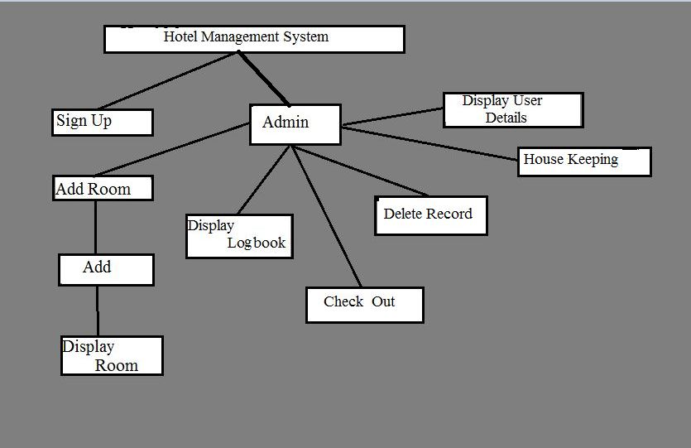
Application Flow Diagram

Slide 10
Future Scope Of Improvement
3
2
Allocation of rooms based on expected vacancies is also difficult as it requires extra work.
1
The proposed Offline Hotel Management System is much more efficient in terms of human and monetary resources.
Database will be much more efficient and faster than the one developed and easier to maintain.

Slide 11
Benefits of our project
GUI
Attractive GUI for Admin interaction. Admin will feel more freedom to access our software.
Effective file management
File System is used in our project to ensure easy record management for the admin.
Validation to ensure error free System
Validation of the code is done to ensure error free records.

Slide 12
What We Learnt ?
Polymorphism Inheritance Encapsulation
Abstraction Classes Objects
Methods Message Passing Dynamic Initialization
Concepts of OOP
Designing
GUI
Used to create window-based applications. It is built on the top of AWT API and entirely written in java.
Unlike AWT, Java Swing provides platform-independent and lightweight components.

Slide 13
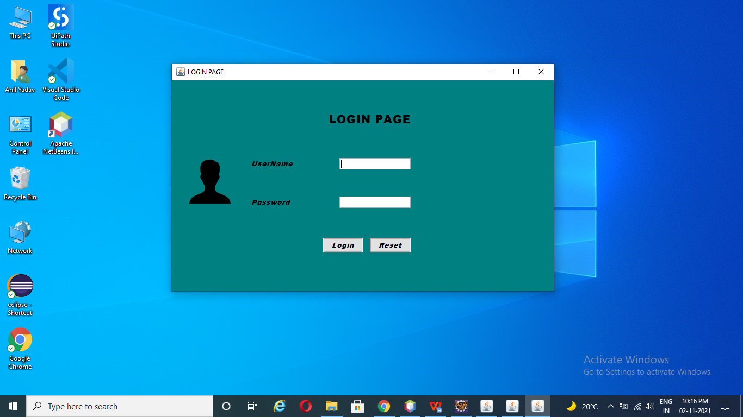
Login _Page

Slide 14
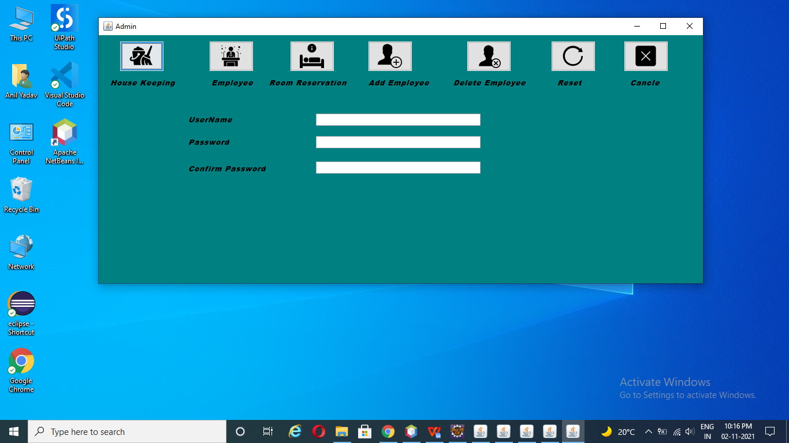
Admin_Page

Slide 15
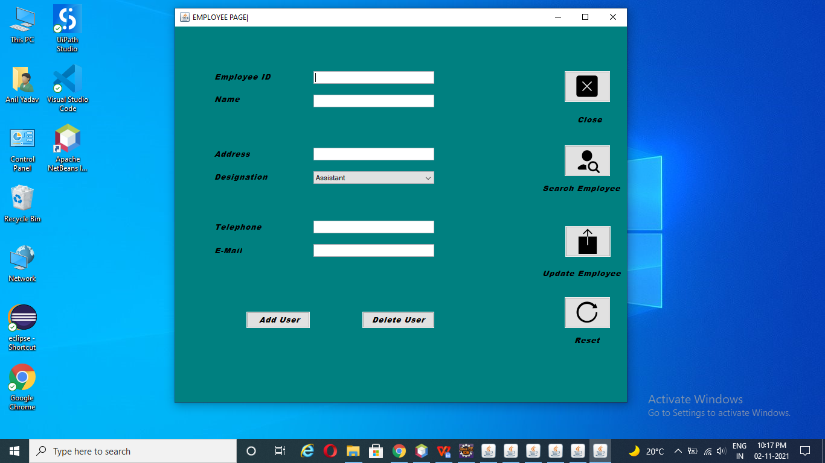
Employee_Page

Slide 16
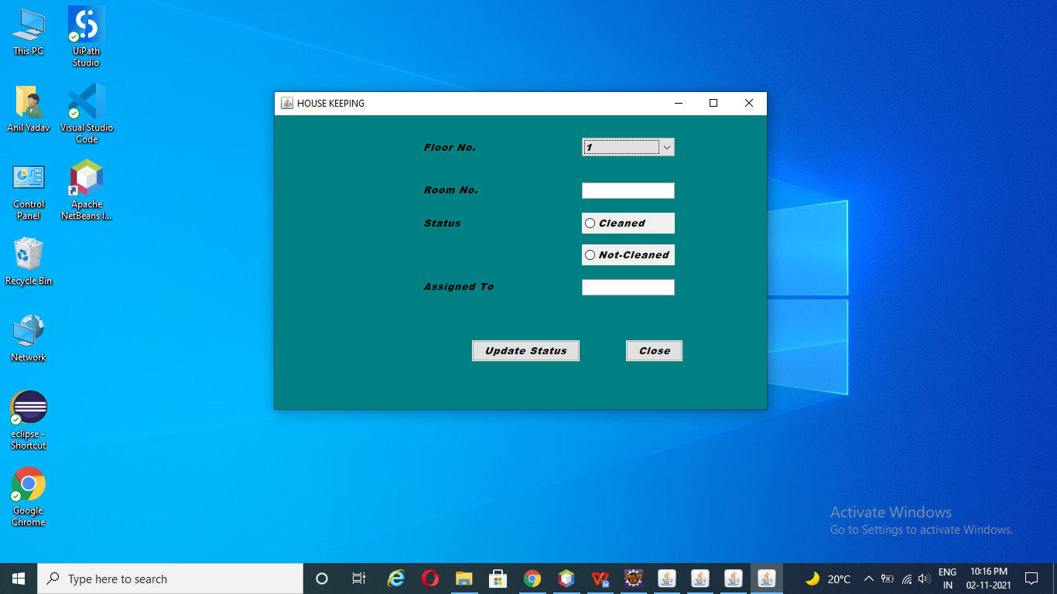
House_Keeping

Slide 17
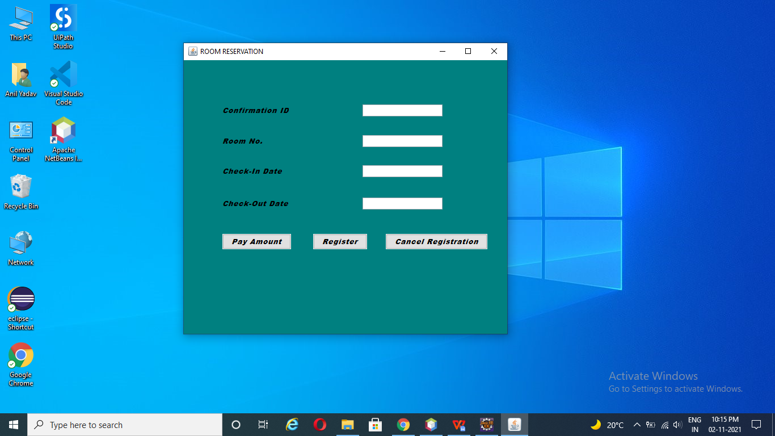
Room_Reservation

Slide 18

CONCLUSION
Hotel Management System
The hotel management system also helps in maintaining the overall activities that take place in the hotel to run smoothly.
Through this hotel management system application even people or the customers can enjoy a very good way of service that they would get.
It will also help the customers to enjoy a smart way of service that they would get from the particular hotel.

Slide 19

THANK YOU!
Have a Good Day!!

